Slide 1

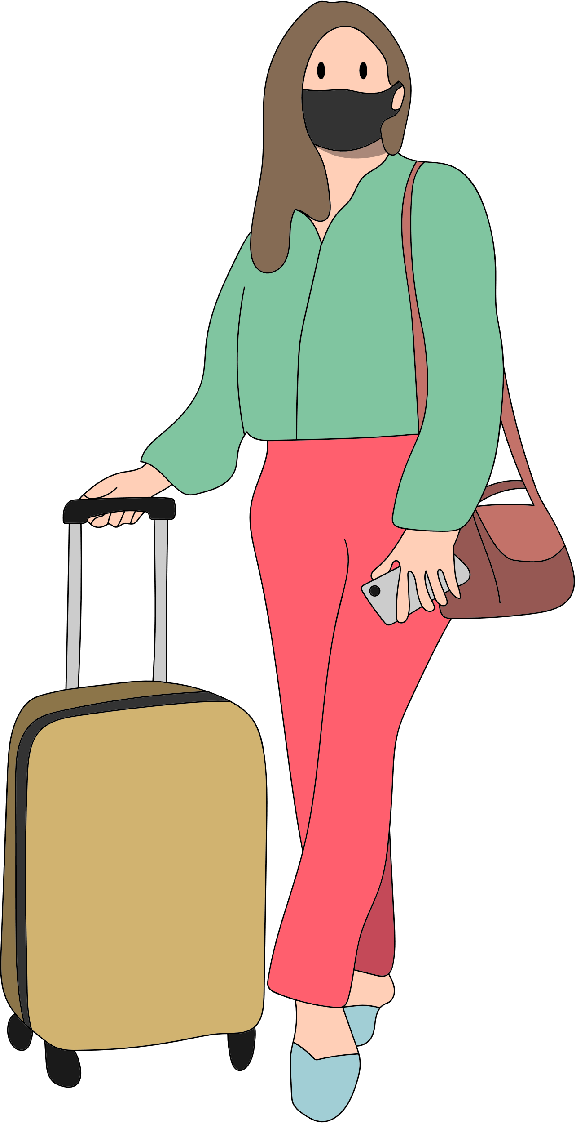

Start Something With Traveling
To identify the different functions of infinitives in sentences.

Slide 2



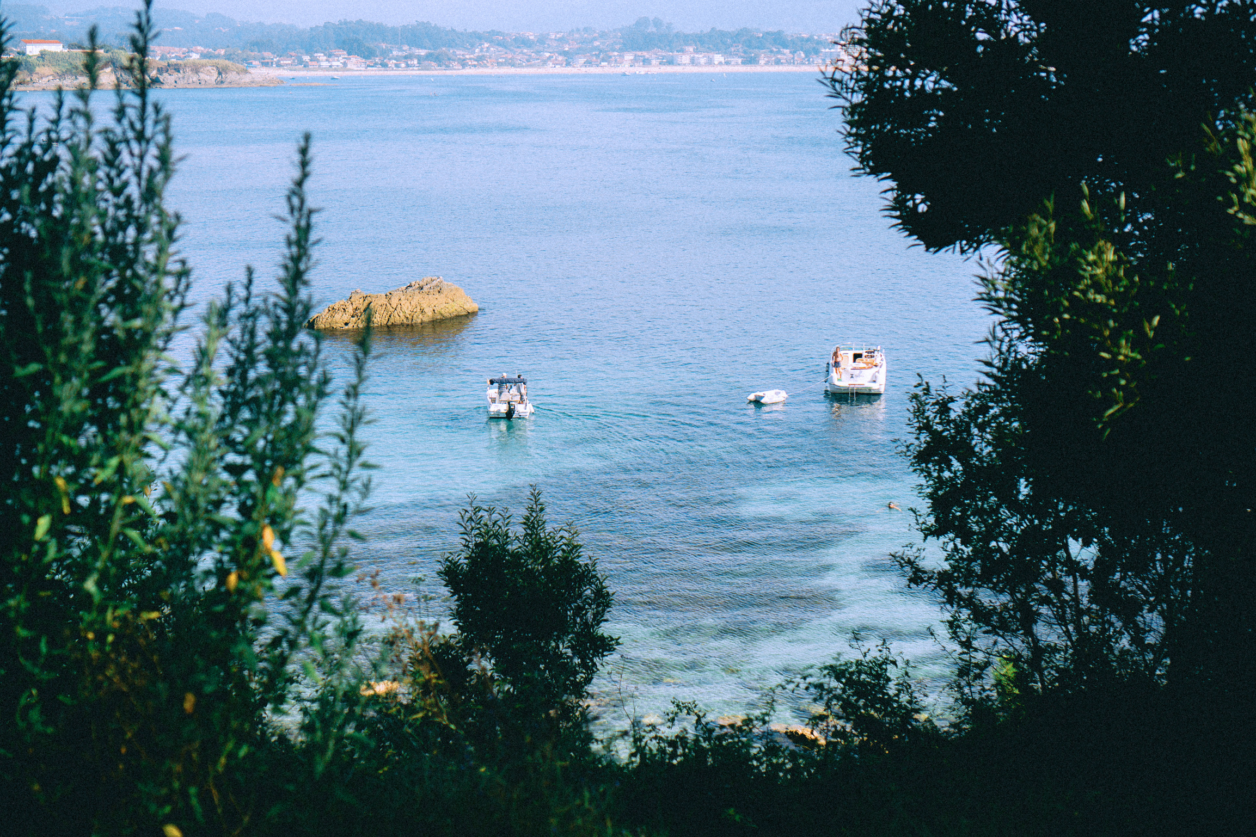


Everytime A New Adventure Your Mood
To identify the different functions of infinitives in sentences.
Get Started

Slide 3

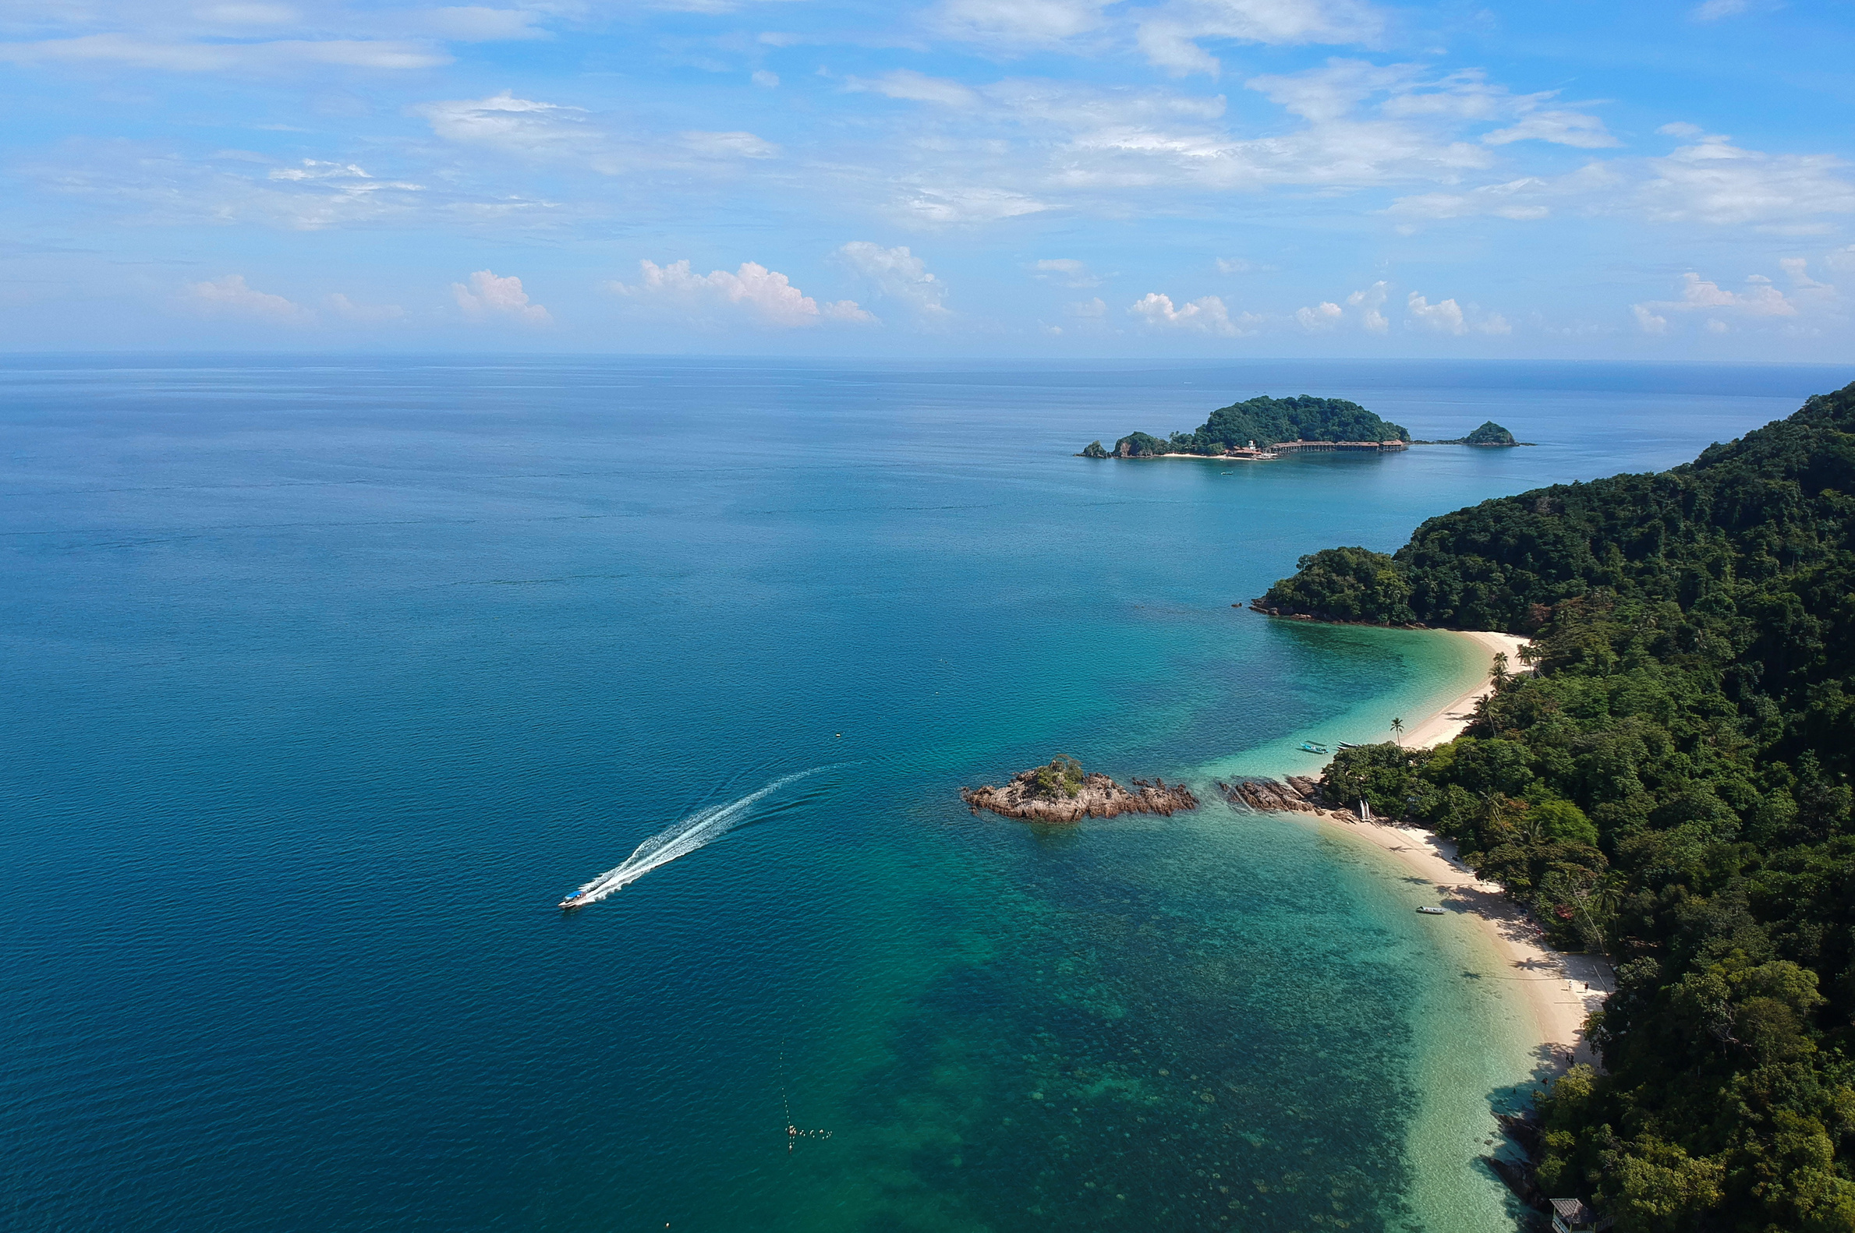



320k
Significant Result
All cource
Over Our Services
presented by
Greta Mae Evans

Slide 4



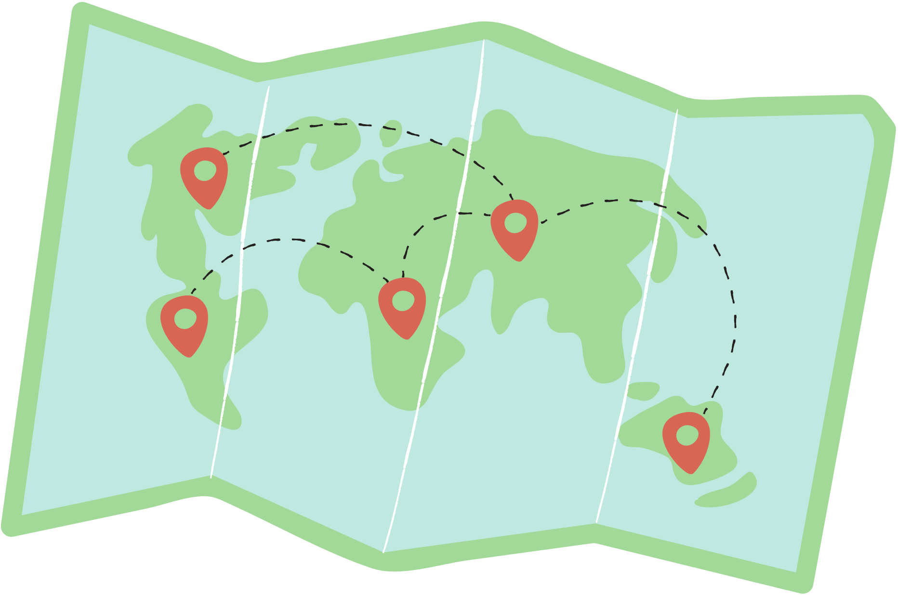

Beautiful Visited Places
White Beach, Boracay
Chocolate Hills, Bohol
Cloud 9, Siargao
Banaue Rice Terraces, Ifugao

Slide 5


Yat Voteans and Lake
a quick escape from the megacity and make their
way down south to Tagaytay, a relaxing town
famous for its cool weather, magnificent views,
and many tourist spots popular for being one of
the best kid-friendly places near Manila.

